Slide 1
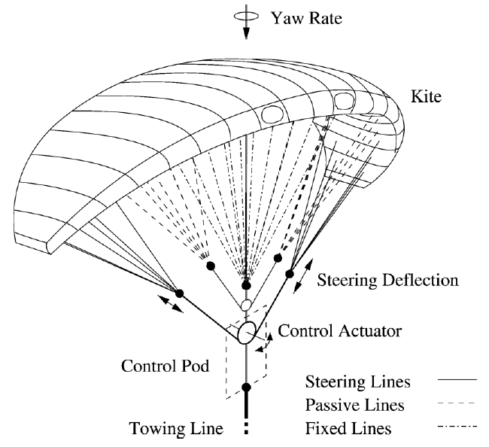


Energy Optimal Control of a Towing Kite
Project Group 1.3
Ashwin Nedungadi - 230397
Mehmet Batu Özmeteler - 230306
Rajesh Pushparaj - 229981

Slide 2
Introduction

Slide 3
What is Model Predictive Control (MPC)?
an advanced control method
uses a model to predict the future behavior of a controlled system over a finite time horizon
computes an optimal control input according to a performance criterion

Slide 4
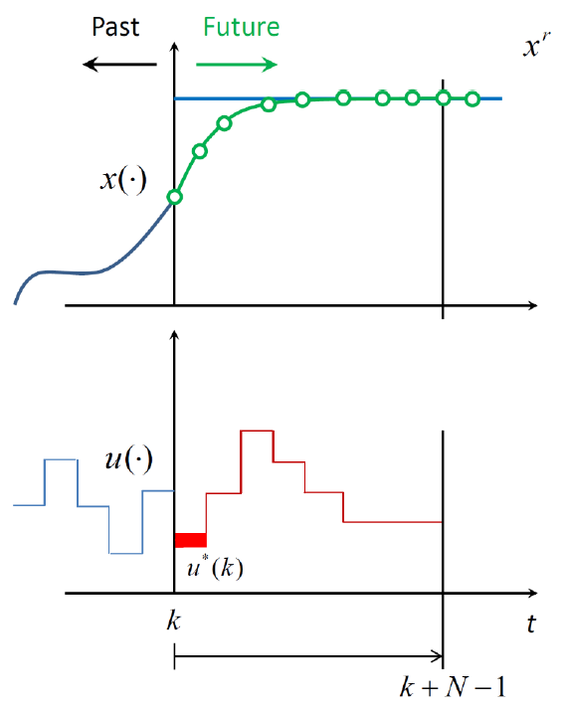
Working Principle
Measure or estimate state information
Compute a sequence of optimal control inputs over a prediction horizon N
Apply the first part of the optimal trajectory
Shift the horizon and repeat

Slide 5
Pros and Cons
can satisfy constraints
can handle MIMO systems
requires large memory and computationally expensive

Slide 6
Problem Formulation

Slide 7
Problem Statement
Dynamic System: a towing kite that is to be used to save the fuel of seagoing vessels
Goal of the Controller: maximize the harvested wind energy while satisfying the minimum height constraint

Slide 8
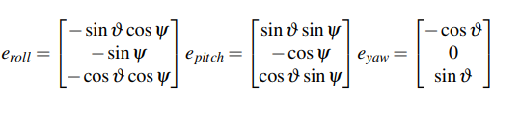
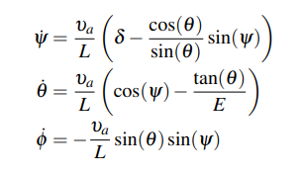
System Overview
Simplified System Vectors
Non-linear Dynamic Model

Slide 9

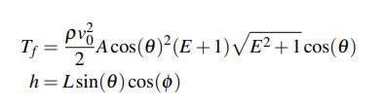
System Overview
Glide Ratio and Relative Wind Speed
Tether Force and Kite Height

Slide 10
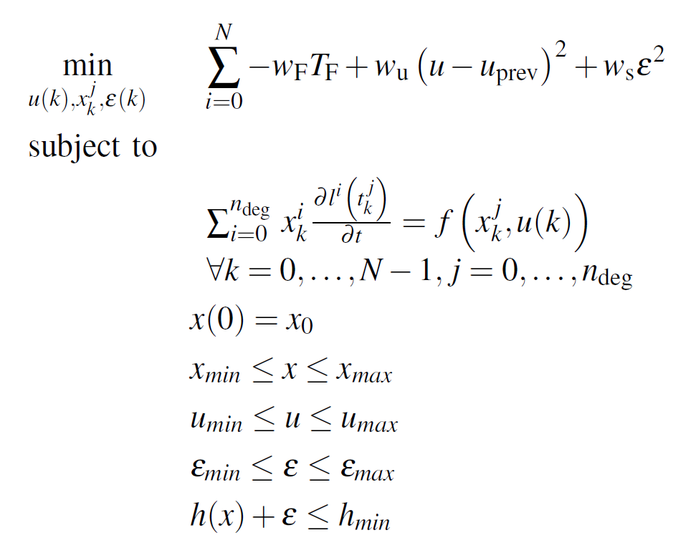
OCP Formulation
maximizes the
tether force
for a smooth
control trajectory
for orthogonal
collocation
slack variable for the soft constraint implementation
state and input constraints
the minimum height constraint

Slide 11
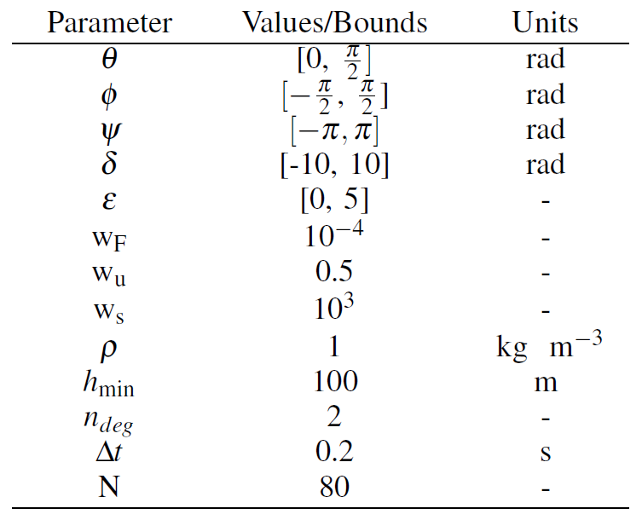
Tuning Parameters

Slide 12
Numerical Implementation

Slide 13
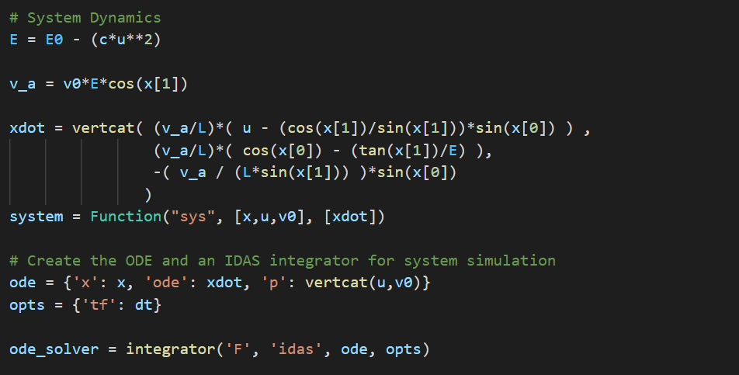
Implementation
Define the system and problem parameters and import the wind_model.py
Define the system dynamics as a CasADi function and create an ODE solver

Slide 14
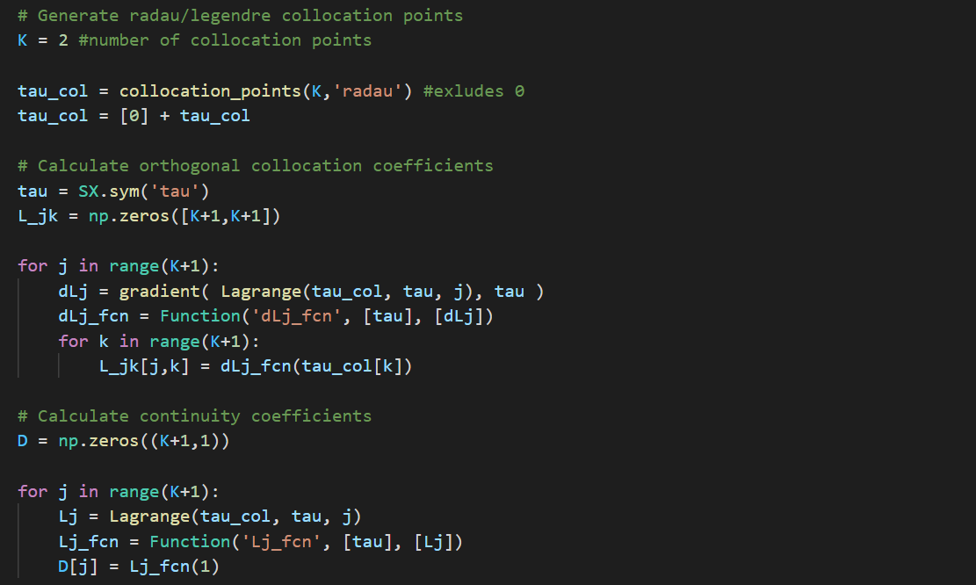
Generate collocation points, find the collocation coefficients and continuity coefficients

Slide 15
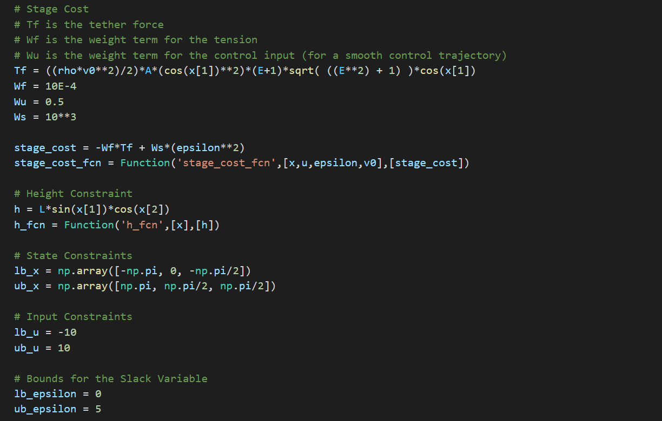
Formulate the tether force and define the stage cost as a CasADi function
Define height constraint as a CasADi function
Set the lower and upper bound for states, input and slack variable

Slide 16
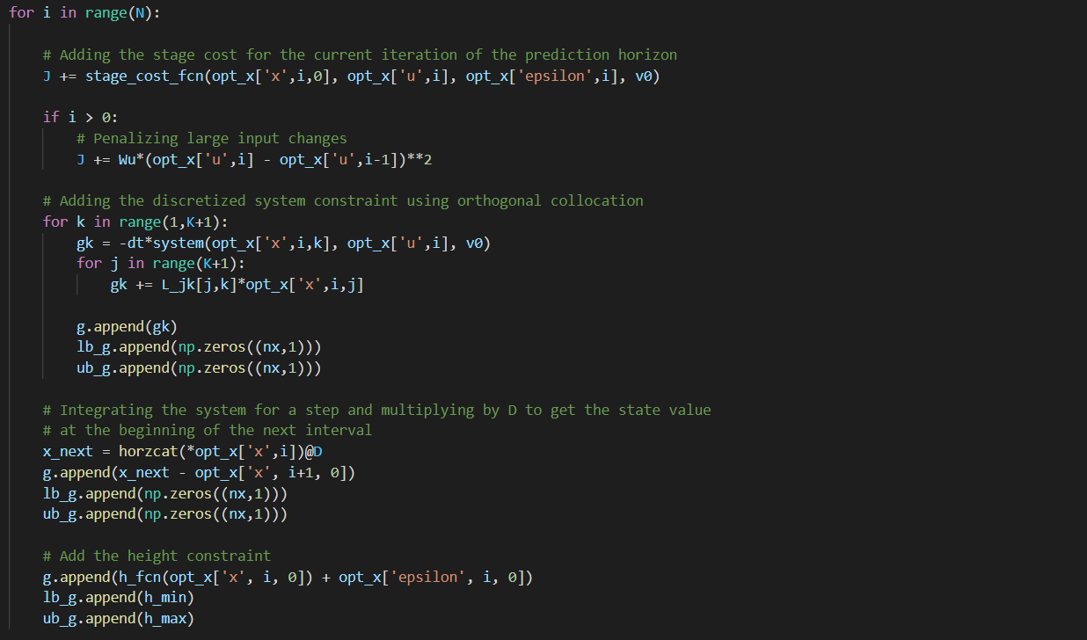
Add the stage cost for the prediction horizon and add the discretized system constraints

Slide 17
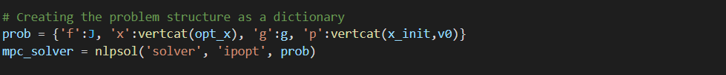
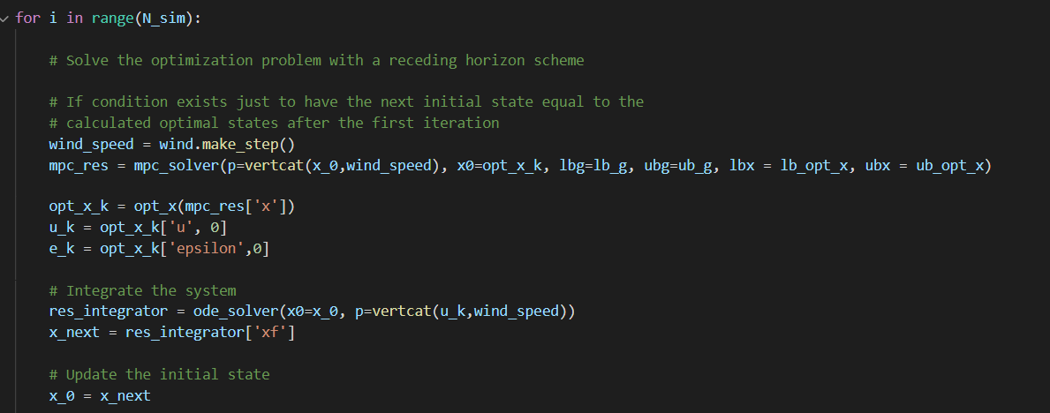
Create the MPC solver using the CasADi function nlpsol
Set initial conditions and initial guesses to solve the open-loop prediction
Use the solution obtained from the open-loop prediction as the initial guess for the MPC loop
Solve the optimization problem with a receding horizon scheme
Store the states and input for each iteration

Slide 18
Results

Slide 19
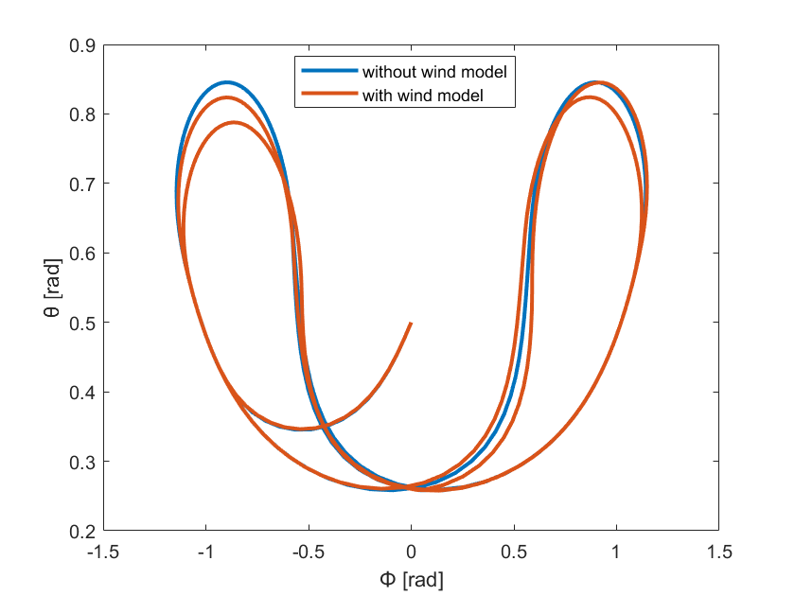
Kite Trajectories

Slide 20
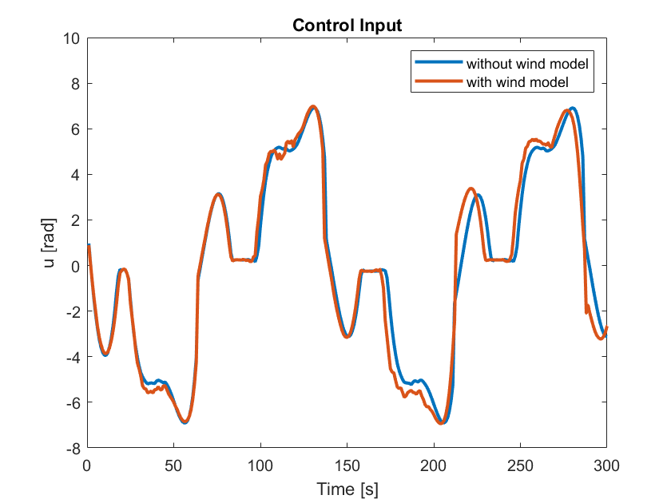
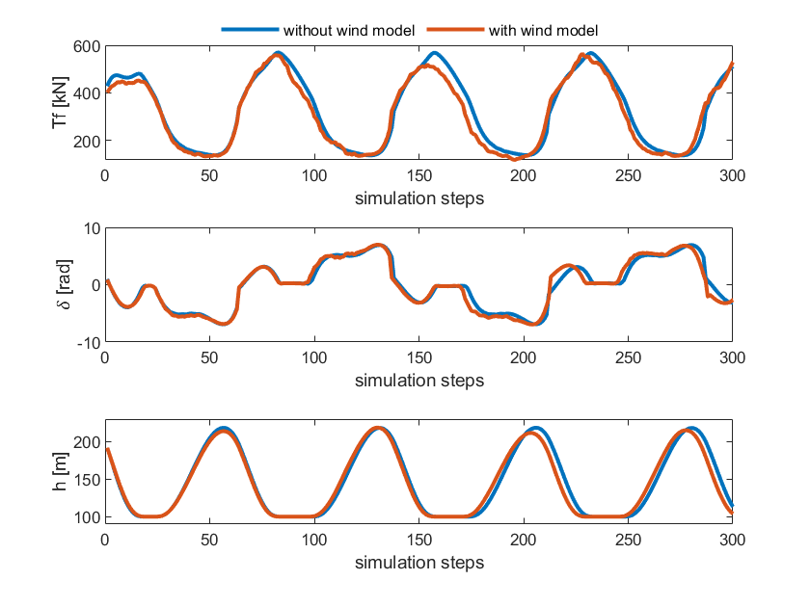
Control Input

Slide 21
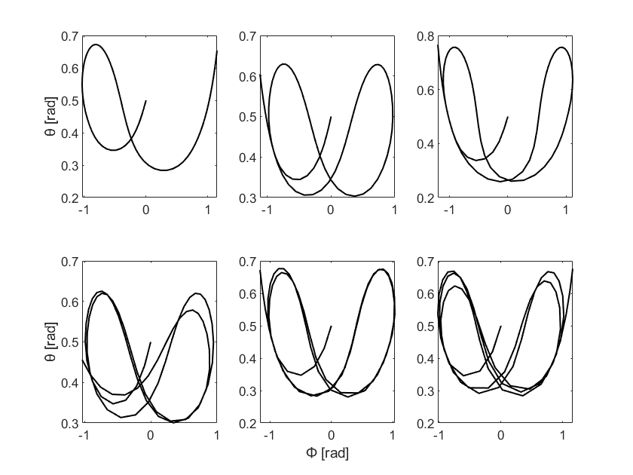
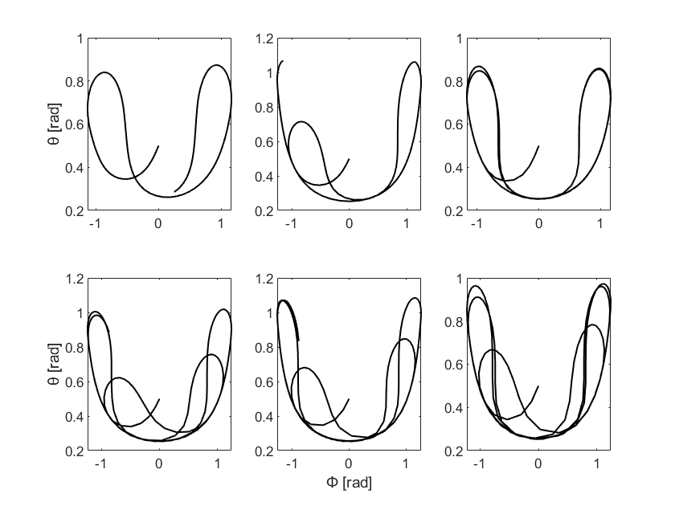
Open-Loop vs. Closed-Loop
Kite Trajectories with Different Constant Relative Wind Speeds – Open-Loop
Kite Trajectories with Different Varying Relative Wind Speeds – Closed-Loop

Slide 22
THANK YOU FOR LISTENING!

